Slide 1


Human - Computer
Interaction
Present by Chi Nguyen

Slide 2
CONTENTS
The human
The computer
The interaction
Paradigms

Slide 3
Why study paradigms
Concerns
  How can an interactive system be developed to ensure its usability?
  How can the usability of an interactive
  System be demonstrated or measured?
History of interactive system design provides paradigms for usable designs

Slide 4
What are paradigms
Predominant theoretical frameworks or scientific world views
- ex: Aristotelian, Newtonian, Einsteinian (relativistic) paradigms in physics
Understanding HCI history is largely about understanding a series of paradigm shifts
  Not all listed here are necessarily “paradigm” shifts, but are at least candidates
  History will judge which are true shifts.

Slide 5
Paradigms of interaction
New computing technologies arrive, creating a new perception of the human-computer relationship.
We can trace some of these shifts in the history of interactive technologies.

Slide 6
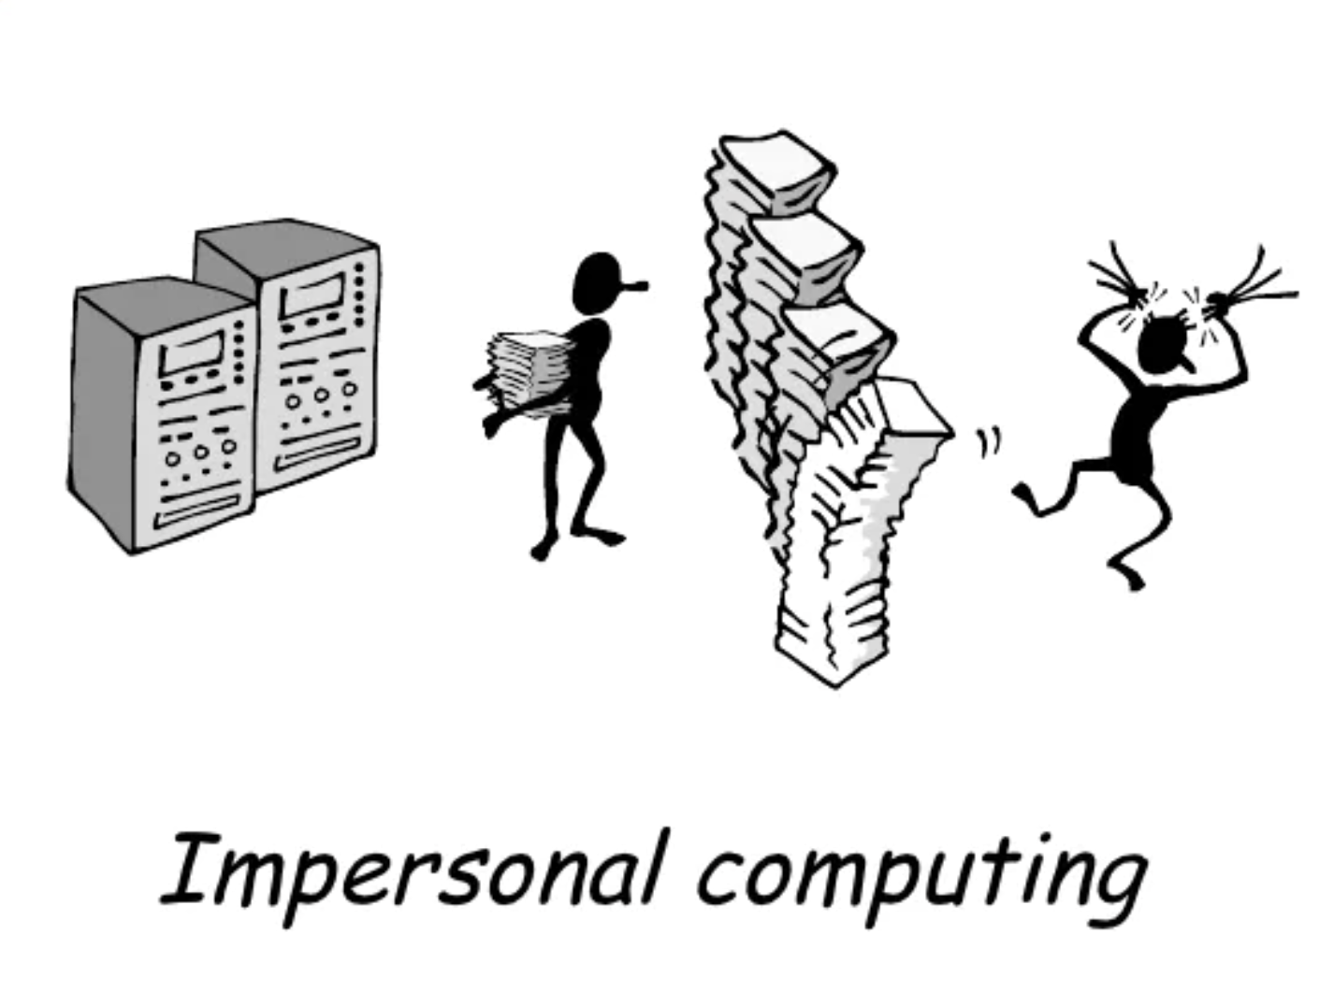
The initial paradigm
& example paradigm shifts
Batch processing
Time-sharing
Networking
Graphical displays
Microprocessor
WWW
Ubiquitous Computing
Notes:
A symbiosis of physical and electronic worlds in services of everyday activities

Slide 7
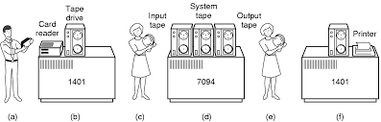
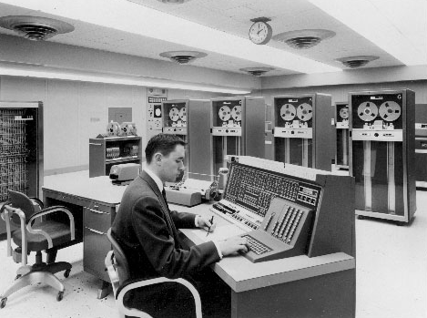
Batch Processing
Computer had one task, performed sequentially
No “interaction” between operator and computer after starting the run
Punch cards, tapes for input
Serial operations

Slide 8
Time-sharing
1940s and 1950s
Explosive technological growth
1960s
Need to channel the power
J.C.R. Licklider at ARPA
Single computer supporting multiple users

Slide 9
Video Display Units
More suitable medium than paper
1962 - Sutherland’s Sketchpad
Computers for visualizing and manipulating data
One person’s contribution could drastically change the history of computing

Slide 10
Personal computing
1970s - Papert’s LOGO language for simple graphics programming by children
A system is more powerful as it becomes easier to user
Future of computing is small, powerful machines dedicated to the individual
Kay at Xerox PARC - The Dynabook as the ultimate personal computer.

Slide 11
Programming toolkit
Engelbart at Stanford Research Institute
1963 - augmenting man’s intellect
1968 NLS/Augment system demonstration
The right programming toolkit provides building blocks to producing complex interactive systems

Slide 12
Window systems and the WIMP interface
Engelbart at Stanford Research Institute
1963 - augmenting man’s intellect
1968 NLS/Augment system demonstration
The right programming toolkit provides building blocks to producing complex interactive systems

Slide 13
Metaphor
Relating computing to other real-world activity is effective teaching technique
  LOGO’s turtle dragging its tail
  File management on an office desktop
  Word processing as typing
  Financial analysis on spreadsheets
  Vitual reality - user inside the metaphor
Problems
  Some tasks do not fit into a given metaphor
  Cultural bias

Slide 14
Direct manipulation
1982 - Shneiderman describes appeal of graphically-based interaction
  Visibility of objects
  Incremental encourages exploration
  Syntactic correctness of all actions
  Replace language with action
1984 - Apple Macintosh
The model-world metaphor
What You See Is What You Get (WYSIWYG)

Slide 15
Language vs Action
Actions don’t always speak louder than words!
DM - Interface replaces underlying system
Language paradigm
Interface as mediator
Interface acts as intelligent agent
Programming by example is both action and language

Slide 16
Hypertext
1945 - Vannervar Bush and the memex
Key to success in managing explosion of information
Mid 1960s - Nelson describes hypertext as non-linear browsing structure
Hypermedia and multimedia
Nelson’s Xanadu project still a dream today

Slide 17
Multimodality
A mode is a human communication channel
Emphasis on simultaneous use of multiple channels for input and output.

Slide 18
Computer Supported Cooperative Work (CSCW)
CSCW removes bias of single user/ single computer system
Can no longer neglect the social aspects
Electronic mail is most prominent success

Slide 19
The World Wide Web
Hypertext, as originally realized, was a closed system
Simple, universal protocols (ex: HTTP) and mark-up languages (ex: HTML) made publishing and accessing easy
Critical mass of user lead to a complete transformation of our information economy.

Slide 20
Agent-based Interfaces
Original interfaces
  Commands given to computer
  Language-based
Direct Manipulation/WIMP
  Commands performed on “world” representation
  Action based
Agents - return to language bu instilling proactivity and “intellignece” in command processor
  Avatars, natural languague processing

Slide 21
Ubiquitous Computing
Mark Weiser, 1991
“The most profound techbologies are those that disappear”
Notes:
Mark D. Weiser (July 23, 1952 – April 27, 1999) was a computer scientist and chief technology officer (CTO) at Xerox PARC.^{[1]} Weiser is widely considered to be the father of ubiquitous computing, a term he coined in 1988.^{[1]} Within Silicon Valley, Weiser was broadly viewed as a visionary and computer pioneer, and his ideas have influenced many of the world's leading computer scientists.

Slide 22
Ubiquitous Computing
Late 1980’s: Computer was very apparent
How to make it disappear?
  Shrink and embed/ distribute it in the physical world
  Design interaction that don’t demand our intention
Notes:
Mark D. Weiser (July 23, 1952 – April 27, 1999) was a computer scientist and chief technology officer (CTO) at Xerox PARC.^{[1]} Weiser is widely considered to be the father of ubiquitous computing, a term he coined in 1988.^{[1]} Within Silicon Valley, Weiser was broadly viewed as a visionary and computer pioneer, and his ideas have influenced many of the world's leading computer scientists.

Slide 23
Sensor-based and
Context-aware interaction
Human are good at recognizing the “context” of a situation and reacting appropriately
Automatically sensing physical phenomena (ex: light, temp, location, identity…) becoming easier
How can we go from sensed physical measures to interactions that behave as if made “aware” of the surroundings?

Slide 24
Extra
+
Some bonus for you

Slide 25
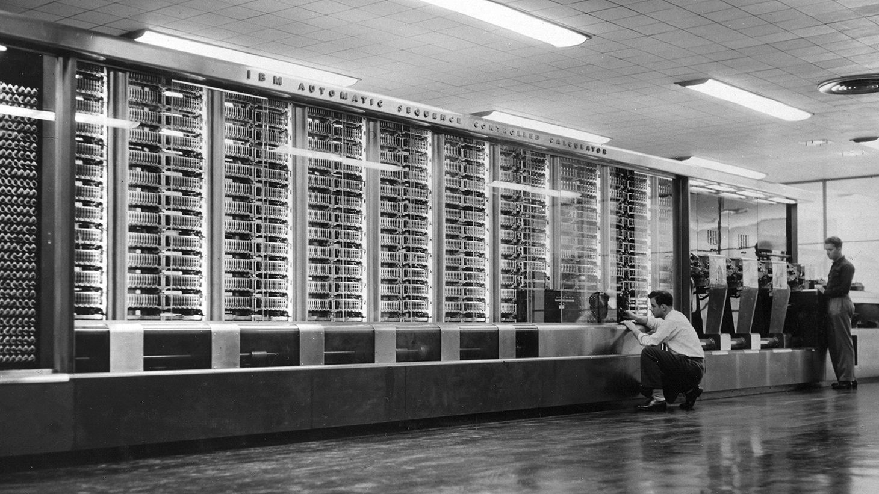
Beginning - Computing in 1945
Harvard Mark I
55 feet long, 8 feet high, 5 tons

Slide 26
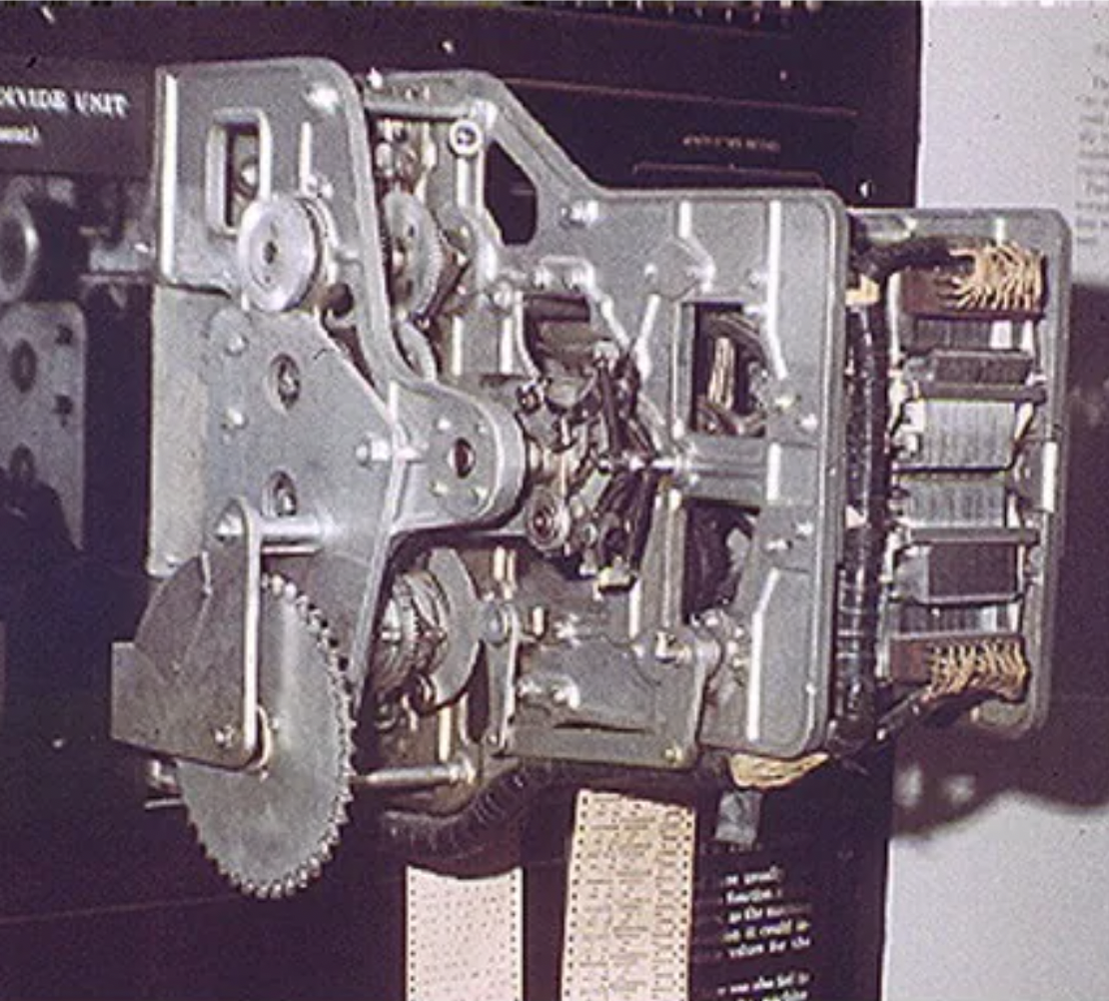
Context - Computing in 1945
Ballistics calculations
Physical switches
(before microprocessor)
Paper tape
Simple arithmetic &
fixed calculations
(before programs)
3 seconds to multiply

Slide 27


Thanks!
Do you have any questions?
chrizmonkey@gmail.com
+84 0937 566 561

